Slide 1
Novosibirsk 2023
Effective
Communication with Dormitory Settlement

Slide 2
Zhitnik Elizabeth
Kozorez Nikita
Kozoliy
Mikhail
Vlasenko Ivan
Backend
Project Logic
Backend
Project Logic
Frontend
Documentation
Team Workflow
Databases
Git

Slide 3


MAIN GOAL

Slide 4
OUR PROJECT

Slide 5
OUR PROJECT
Unified database

Slide 6
OUR PROJECT
Unified database
User-friendly interface

Slide 7
OUR PROJECT
Unified database
User-friendly interface
Notification System

Slide 8




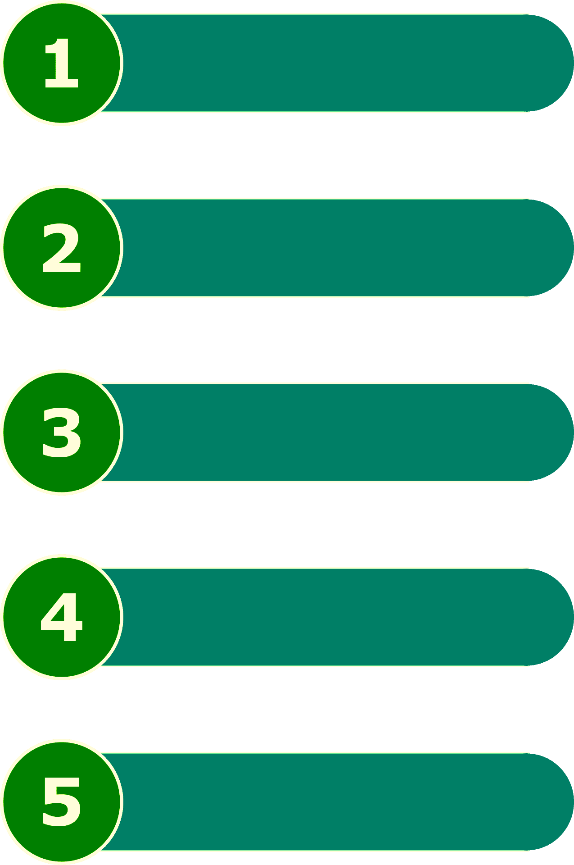





OUR PROJECT
Unified database
User-friendly interface
Notification System
Connect issue

Slide 9


Slide 10
Database structure
ROOMS
Number
Dormitory
Floor
Capacity
STUDENT ACCOMODATION
ID
Dormitory
Room
Contract
Contract Start
Contract End
STUDENT
ID
Name
Surname
Patronymic
Group Number
Faculty
FLOORS
Number
Room
Height
DORMITORY
Name
Floor
Contact Number

Slide 11


Slide 12
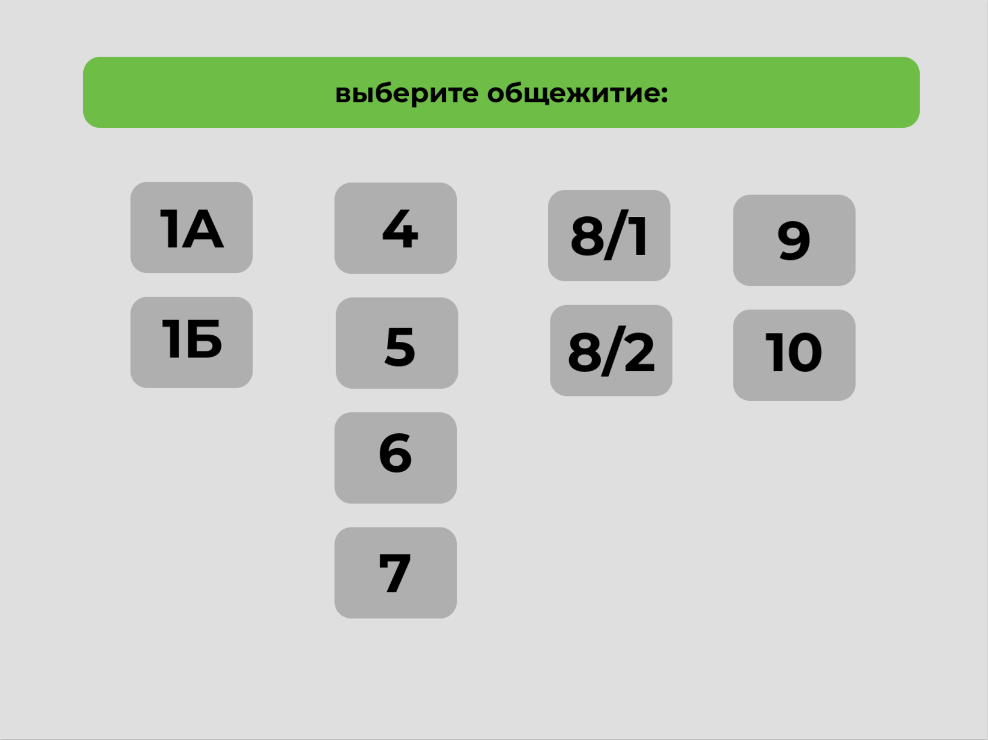
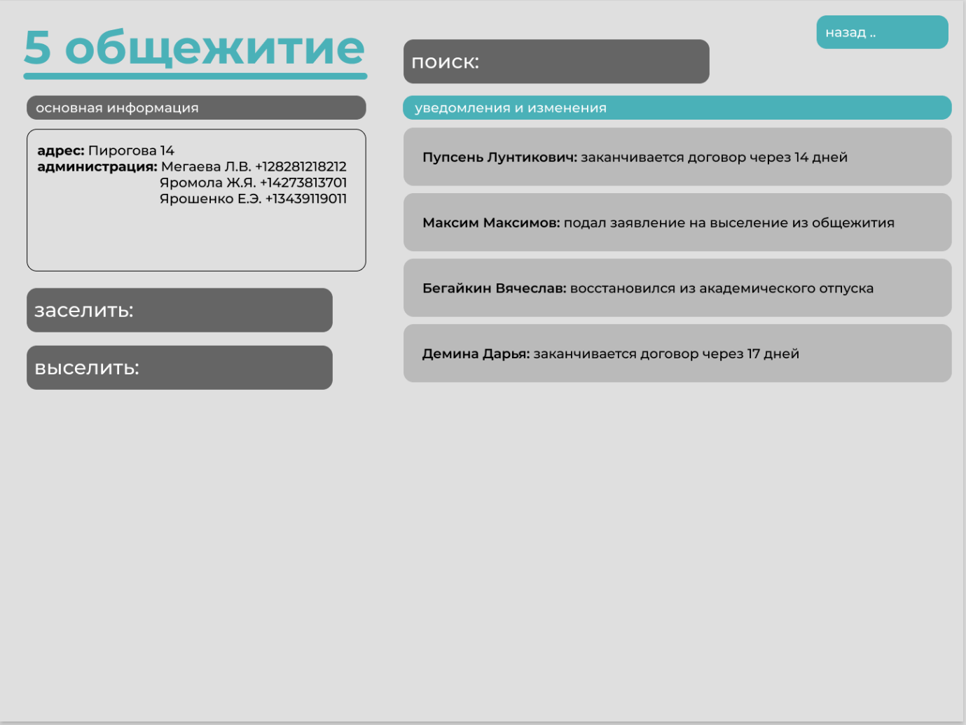
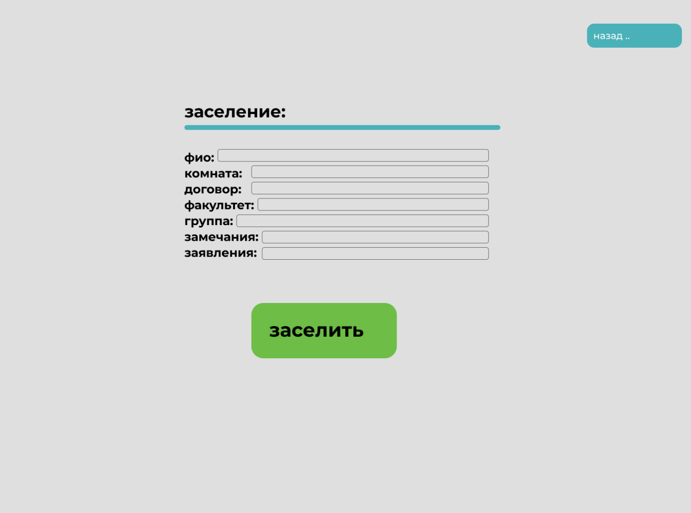
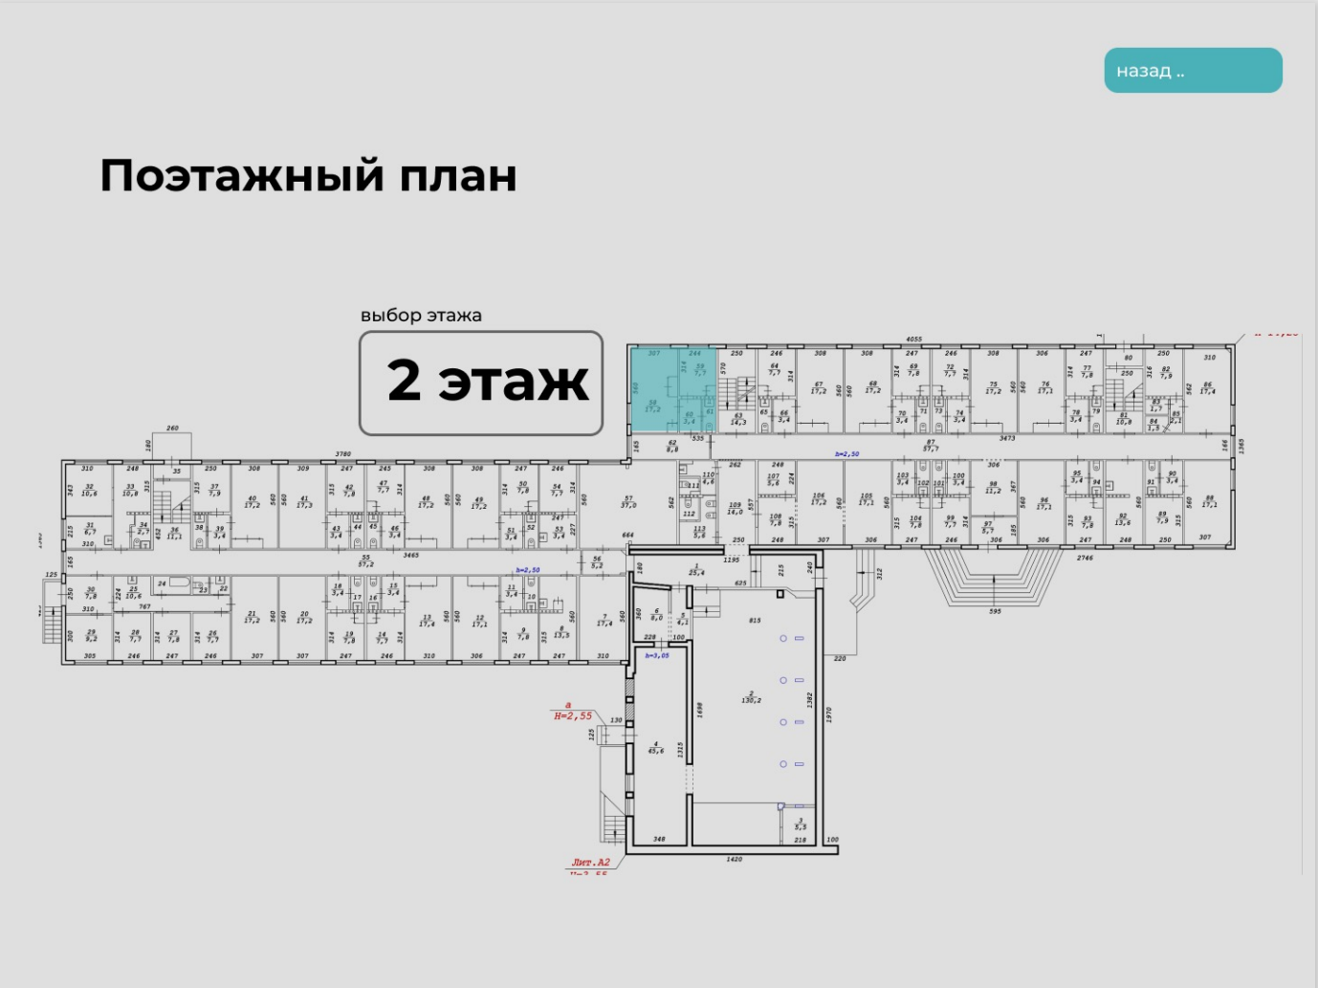
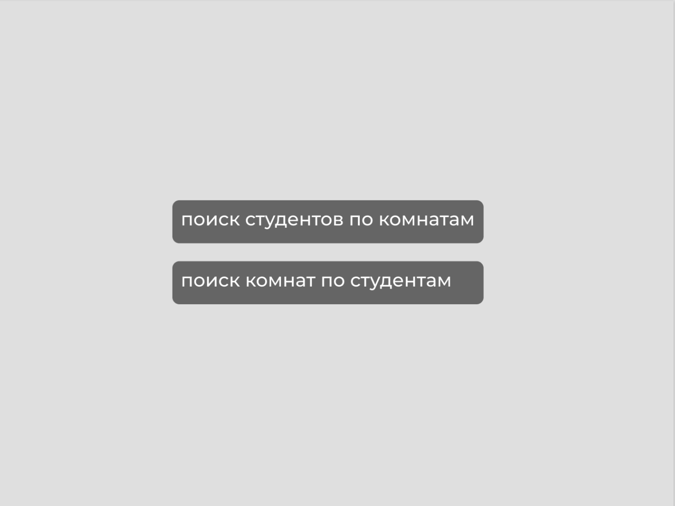
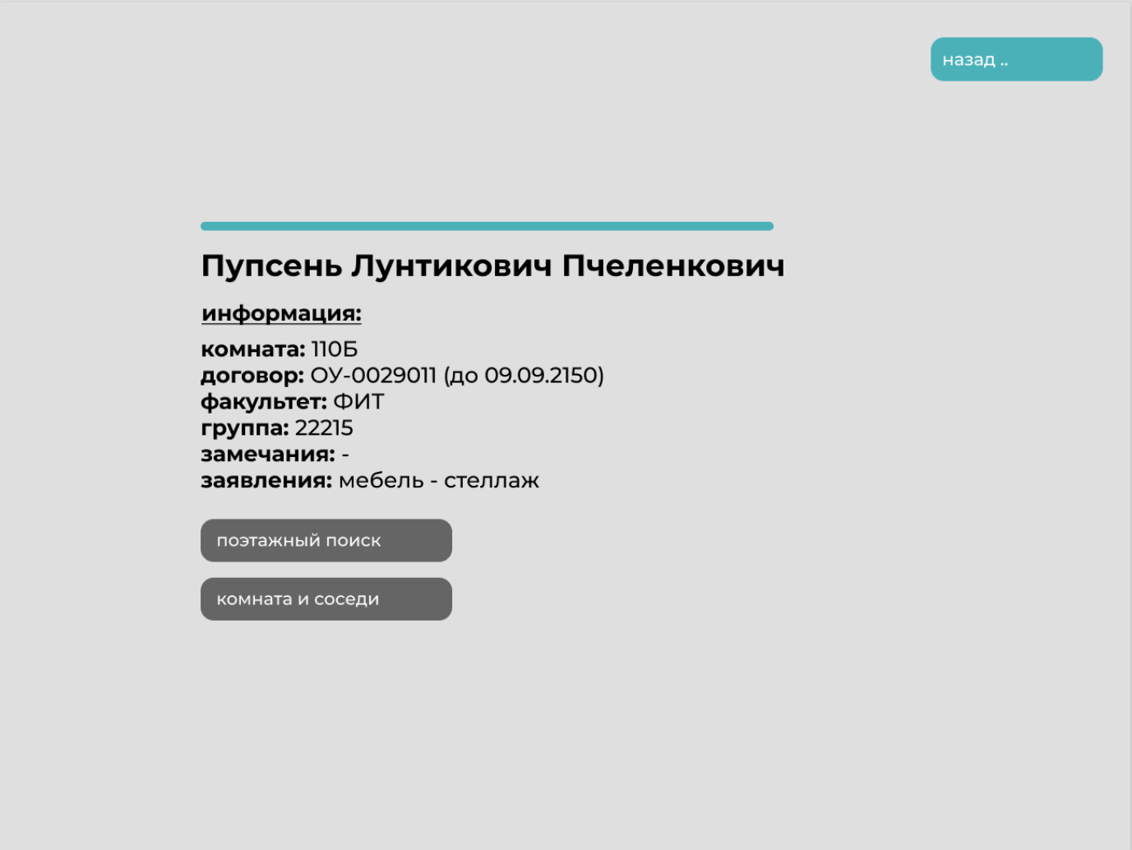
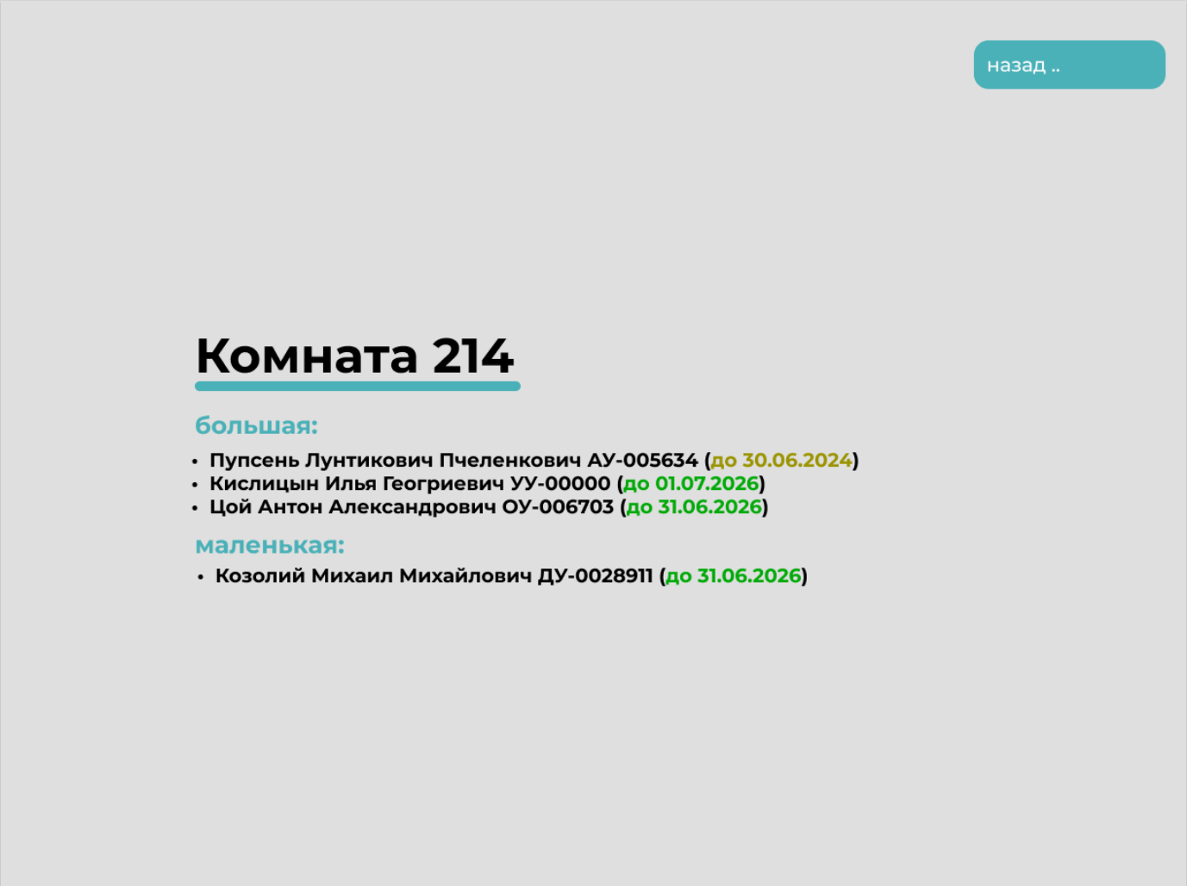
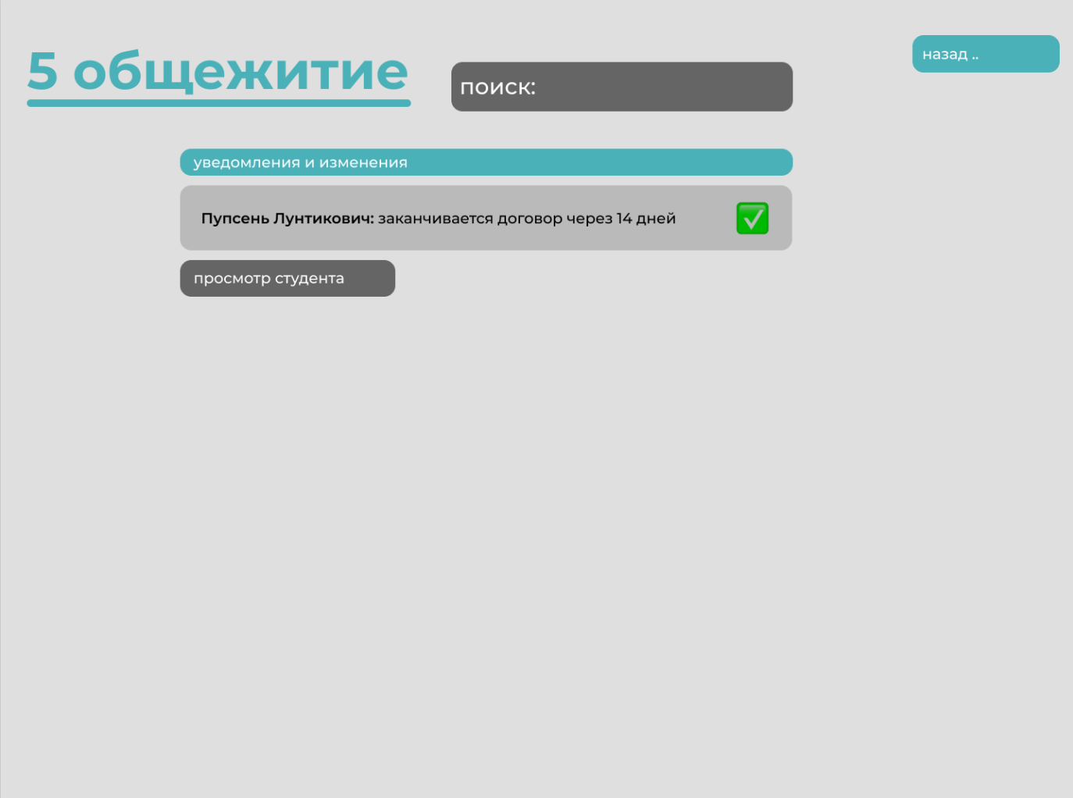
Interface

Slide 13
Interface

Slide 14
Interface

Slide 15
Interface

Slide 16
Interface

Slide 17
Interface

Slide 18
Interface

Slide 19
Interface

Slide 20
Notifications

Slide 21
System requirements

Slide 22


System requirements
GIT
NOTION

Slide 23
Novosibirsk 2023
Effective
Communication with Dormitory Settlement

